Slide 2
Objective:
The primary objective of this analysis is to evaluate energy production data to:
Conduct Exploratory Data Analysis (EDA) to identify and visualize key factors influencing energy production levels, analyzing relationships between variables such as temperature, exhaust vacuum, ambient pressure, and relative humidity. This includes cleaning the dataset by addressing missing values and removing outliers to enhance data quality.
Develop and implement predictive models to estimate energy production based on the identified features. Techniques such as multiple linear regression will be utilized to assess the impact of various factors on energy production.
Deploy the developed models in a user-friendly application or interface, enabling stakeholders to access predictions and insights. The goal is to provide actionable recommendations based on the model’s findings to optimize energy production processes effectively.

Slide 3
Challenges Faced
1. **Data Quality Issues:**
Encountered missing values and duplicates in the dataset, which required extensive cleaning to ensure accuracy.
2. **Outlier Detection:**
Identifying and removing outliers was challenging, as they could significantly impact model performance and interpretation.
3. **Feature Correlation:**
Understanding the relationships between features and their effects on energy production posed difficulties, necessitating careful analysis.
4. **Model Selection:**
Choosing the appropriate predictive model involved testing multiple algorithms to determine the best fit for the dataset.
5. **Interpretability of Results:**
Ensuring that the model's findings were easily interpretable for stakeholders required simplifying complex statistical outputs.
6. **Deployment Challenges:**
Implementing the model into a user-friendly application involved technical challenges, including integration and ensuring usability.

Slide 4
Dataset Overview
The dataset consists of the following variables:
1. Temperature (Celsius)
2. Exhaust Vacuum (cm Hg)
3. Ambient Pressure (millibar)
4. Relative Humidity (%)
5. Energy Production (MW)
Objective: Analyze how these variables impact energy production.

Slide 5
Sample Data
The table includes 5 key variables related to energy production.
Each row in the table is a sample observation, showing values for temperature, exhaust vacuum, ambient pressure, relative humidity, and the resulting energy production.
Temperature | Exhaust Vacuum | Ambient Pressure | Relative Humidity | Energy Production
9.59 | 38.56 | 1017.01 | 60.10 | 481.30
12.04 | 42.34 | 1019.72 | 94.67 | 465.36
13.87 | 45.08 | 1024.42 | 81.69 | 465.48
13.72 | 54.30 | 1017.89 | 79.08 | 467.05
15.14 | 49.64 | 1023.78 | 75.00 | 463.58

Slide 6


Loading Data and Missing Value Assessment
1. Loading Data
Code Snippet:
Description:
The dataset is loaded into a DataFrame using the pandas library.
Ensure to replace "path_to_your_file.csv" with the actual path of your CSV file
2. Checking for Missing Values
Code Snippet:
Description:
This line of code checks for missing values in the dataset.
It calculates the total number of missing values for each column.
This assessment is crucial for understanding data quality and informing preprocessing steps.

Slide 7
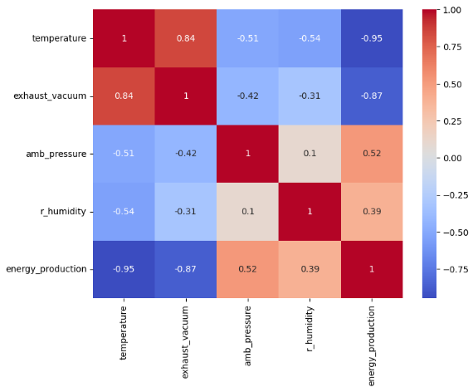
Exploratory Data Analysis (EDA) Visualizations
Correlation Heatmap Visualizes the strength and direction of relationships between variables.

Slide 8
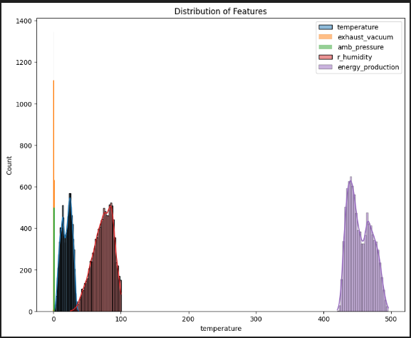
2.Distribution of Features Visualizes the distribution of individual features to understand their characteristics.

Slide 9
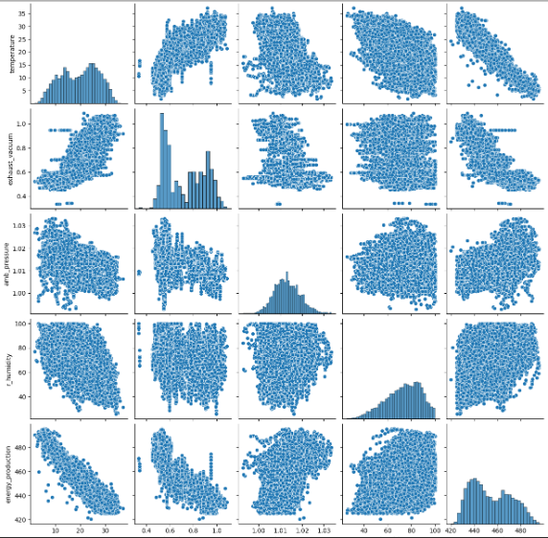
3.Pairplot Displays pairwise relationships and distributions among multiple features.

Slide 10
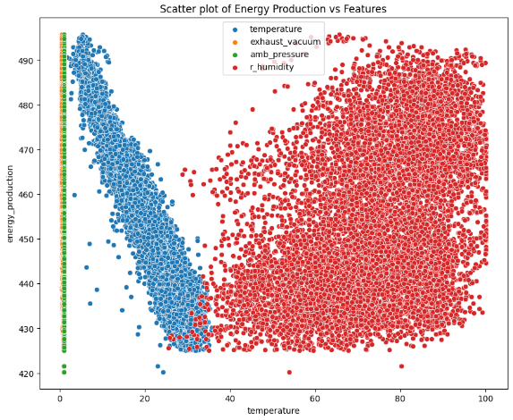
4.Scatter Plots Shows the relationship between energy production and other features, highlighting correlations.

Slide 11
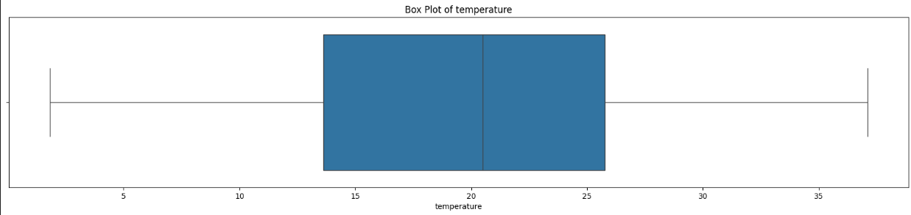
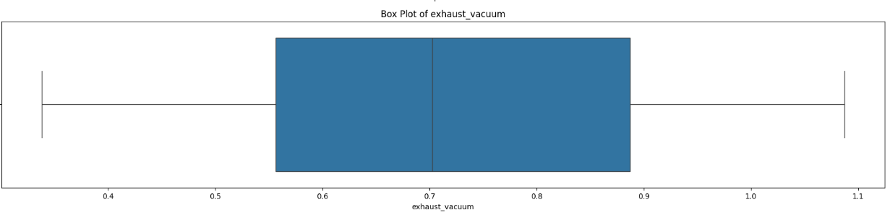
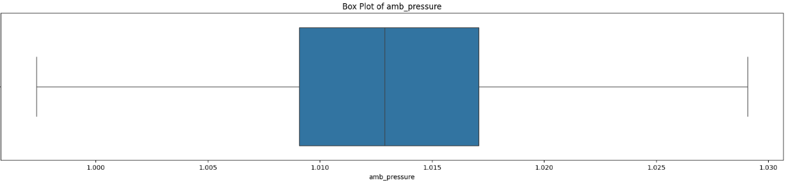
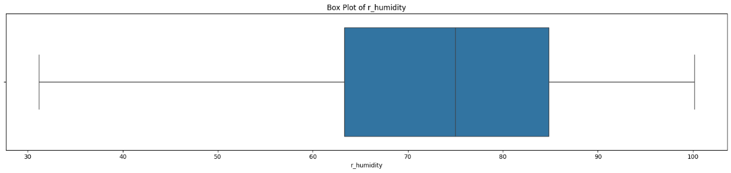
5.Box Plots Identifies outliers and visualizes distributions for numerical features, aiding in data cleaning and analysis.

Slide 12
Model Building Overview
Fundamental Role in Data Science: Model building serves as a cornerstone of data science, enabling us to derive meaningful insights and make informed predictions based on available data. It is the process of selecting, training, and validating models that can effectively learn from data patterns.
Importance of Predictions: Accurate predictions can significantly impact decision-making in various fields, such as finance, healthcare, marketing, and environmental science. Through model building, we can turn raw data into actionable intelligence, guiding strategies and optimizing outcomes.
Models Under Evaluation: In this analysis, we will explore and evaluate several regression models, each with unique characteristics and methodologies:
Linear Regression: A fundamental model that establishes a linear relationship between the dependent and independent variables. It is easy to interpret and provides a baseline for performance comparisons.
Ridge Regression: An extension of linear regression that includes L2 regularization. It helps address multicollinearity by adding a penalty term, improving model robustness.
Lasso Regression: Similar to Ridge but employs L1 regularization, which can drive some coefficients to zero, effectively performing variable selection and simplifying the model.
Decision Tree: A non-linear model that splits the data into subsets based on feature values. It is intuitive and can capture complex interactions, but is prone to overfitting without proper tuning.
Random Forest: An ensemble method that combines multiple decision trees to improve predictive accuracy and control overfitting. It averages the predictions of individual trees, resulting in a more reliable model.
XGBoost: A powerful and efficient implementation of gradient boosting, known for its speed and performance in handling large datasets. It incorporates advanced regularization techniques to enhance model generalization.
Objective of Evaluation: By assessing these diverse models, we aim to identify the most effective approach for our specific dataset, ensuring optimal predictive performance and reliability in our findings

Slide 13
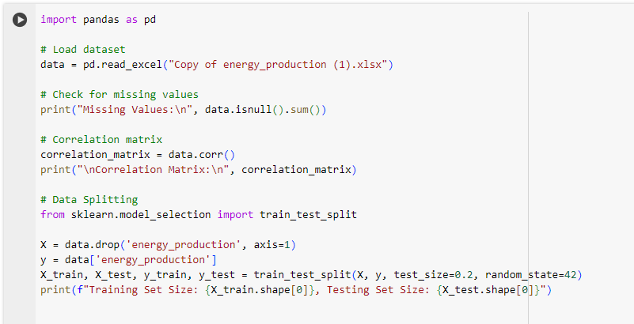
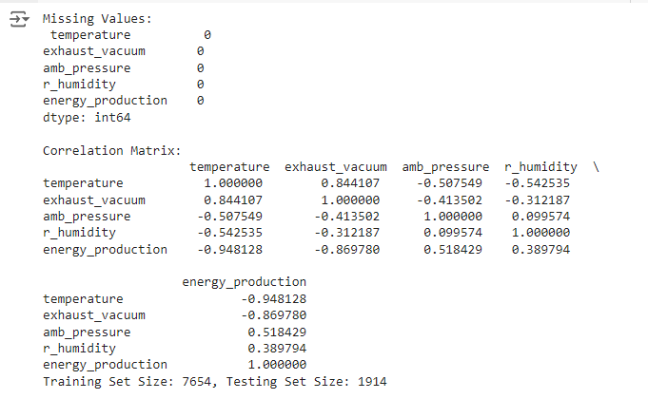
Data Preparation and Splitting
Data Preparation:
Check for missing values and correlation to identify multicollinearity. Code:

Slide 14
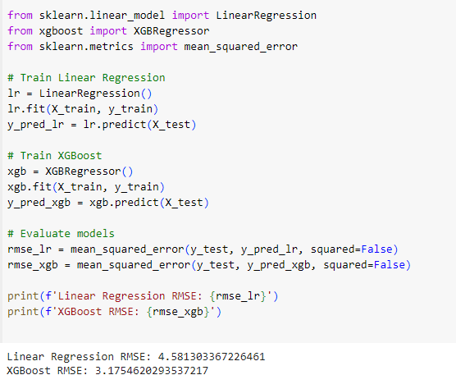
Model Training and Evaluation
Model Training:
We train Linear Regression and XGBoost to predict energy production.
Code:

Slide 15
Summary of Model Building and Evaluation
XGBoost Performance: The XGBoost model demonstrated superior predictive capabilities, achieving the lowest Root Mean Square Error (RMSE) among all tested models. This result emphasizes the effectiveness of XGBoost in handling complex datasets and its ability to capture intricate patterns within the data.
Importance of Model Building: Model building is a fundamental aspect of the data science workflow. It directly influences the accuracy and reliability of predictions made from the data. By carefully selecting and tuning the right models, data scientists can enhance the decision-making process across various domains. The process involves:
Data Preparation: Proper data preprocessing ensures the model has access to clean, relevant, and well-structured data.
Model Selection: Choosing the right algorithms based on the nature of the data and the problem at hand is essential for achieving optimal results.
Evaluation and Validation: Continuous evaluation through metrics like RMSE allows for assessing the model's performance and making necessary adjustments.
Impact on Prediction Accuracy: The choice of model significantly affects the quality of predictions. By leveraging advanced algorithms like XGBoost and optimizing model parameters, we can achieve a higher degree of accuracy, which is crucial for making informed decisions in real-world applications.

Slide 16

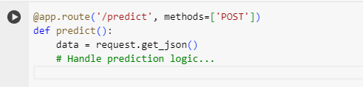
EnergyPredictionAPI Deployment
Overview
The EnergyPredictionAPI is a Flask web application designed to predict energy production based on input features using a pre-trained XGBoost model.
Key Components:
Model Loading:
Loads a pre-trained XGBoost model to ensure accurate predictions.
Code:
Flask Routes:
/: Serves the main index page for user interaction.
/predict: Endpoint for making predictions based on user input.
Code:

Slide 17


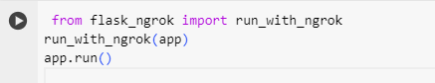
Input Data Handling:
Accepts three features: exhaust_vacuum, amb_pressure, and r_humidity.
Checks for missing features and responds with error messages if any are absent.
Code:
Prediction Logic:
Utilizes the loaded model to predict energy production.
Returns the predicted value as a JSON response.
Code:
Running the Application:
Use ngrok to run the application in Google Colab for external access.
Code:

Slide 18
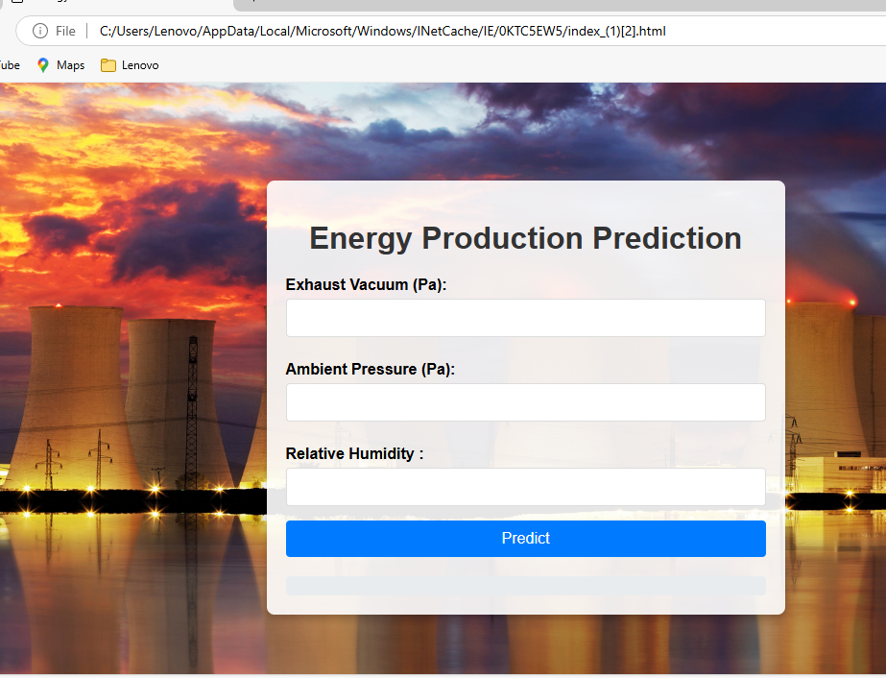
This tool predicts energy production based on three environmental factors:Exhaust Vacuum (Pa)
Ambient Pressure (Pa)
Relative Humidity (%)

Slide 19
Conclusion
The journey through our data science project began with Exploratory Data Analysis (EDA), where we meticulously examined the dataset to uncover valuable insights. By leveraging visualizations such as scatter plots, heatmaps, and pair plots, we identified significant patterns and correlations among features, which laid the groundwork for informed model selection.
Moving into the Model Building phase, we evaluated a range of regression models: Linear Regression, Ridge, Lasso, Decision Tree, Random Forest, and XGBoost. Among these, XGBoost stood out as the most effective model, achieving the lowest RMSE. Its superior performance highlighted its capability to manage complex data structures and interactions effectively. We also implemented feature selection and hyperparameter tuning techniques to further enhance the model's accuracy.
Following the model training, we transitioned to Deployment by developing the EnergyPredictionAPI using Flask. This allowed us to create a user-friendly web interface for real-time energy production predictions. The deployment process included integrating the re-trained XGBoost model, ensuring seamless predictions based on user inputs for relevant features. Additionally, we focused on robust error handling and data validation to guarantee the API's reliability.

